Slide 1
Taylor & Francis Author Workflow & Research Dashboard Demo
00/00/2022

Slide 2
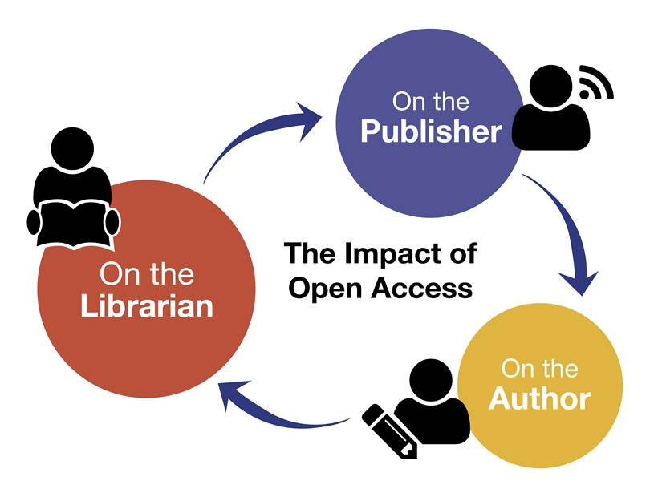
Visibility, Workflow and Communication

Slide 3
Key Features of the Workflow
For the Library
For the Researcher
Individual Research Dashboard accounts to approve article eligibility under the agreement
Libraries have full control over which articles to approve
Real time self service reporting
Reduces administration around OA
Dedicated workflow contacts at T&F
Affiliation based workflow: matching engine identifies eligibility
Clear messaging at each stage of the process to alert them to the agreement in place
Communication to confirm funding approval
Choice of Creative Commons licence

Slide 4
Workflow for an Open Select Article at Taylor & Francis
Published
OA
Article is published as open online
Peer Review
Author chooses OA
Article enters peer review
6
4
License
2
Acceptance
Author signs an OA license
Submission
Article is accepted for publication
Author submits article
OA
Article approved for OA funding via Research Dashboard
5
1
3

Slide 5
From Article Acceptance: 2 different workflows, depending on how quickly the library and author take action

Slide 6
1. Library approval for OA funding via Dashboard *before* author has signed publishing agreement
Author goes to online licence system to sign publishing agreement
Author directed to OA licence option
Library approves OA funding for article via Research Dashboard
Article accepted and metadata populates the Research Dashboard
The default workflow

Slide 7
2. Author signs publishing agreement and chooses OA before library approves for OA funding via Dashboard
Article accepted and metadata populates the Research Dashboard
Author shown OA question on licensing system and chooses OA
Author signs OA publishing agreement
Author informed of institution’s OA agreement
Article added to ‘Action Required’ tab on Research Dashboard
Library informed and approves OA funding requests

Slide 8
Workflow 1:
Library approval for OA funding via Dashboard before author has signed publishing agreement

Slide 9
New Article Email to Author
Send To: Author Email
Subject: Your article with Taylor & Francis
Body:
Dear Author First Name Last Name,
Re: Article Title; Journal Title
Congratulations on the recent acceptance of your manuscript submission to Journal Title. The Taylor & Francis production team will work with you to publish your article online as quickly as possible.
We would like to let you know that your institution has an open access agreement with Taylor & Francis, which means you may be eligible for funding to publish your article open access. We have let them know that your paper has been accepted and shared your article information, including your email address.
What happens next?
It’s important to know that not all articles will be eligible for funding under this agreement, so please click here to view the latest information.
If your institution approves open access funding for your article, we will let you know. You may also request approval by selecting the open access option.
Look out for an email inviting you to select and sign your article publishing agreement.
If you have any questions, please do not hesitate to contact apc@tandf.co.uk, or your librarian.
Kind regards,
Mark Robinson
Taylor & Francis open access team
Email to author, alerting them to OA agreement

Slide 10
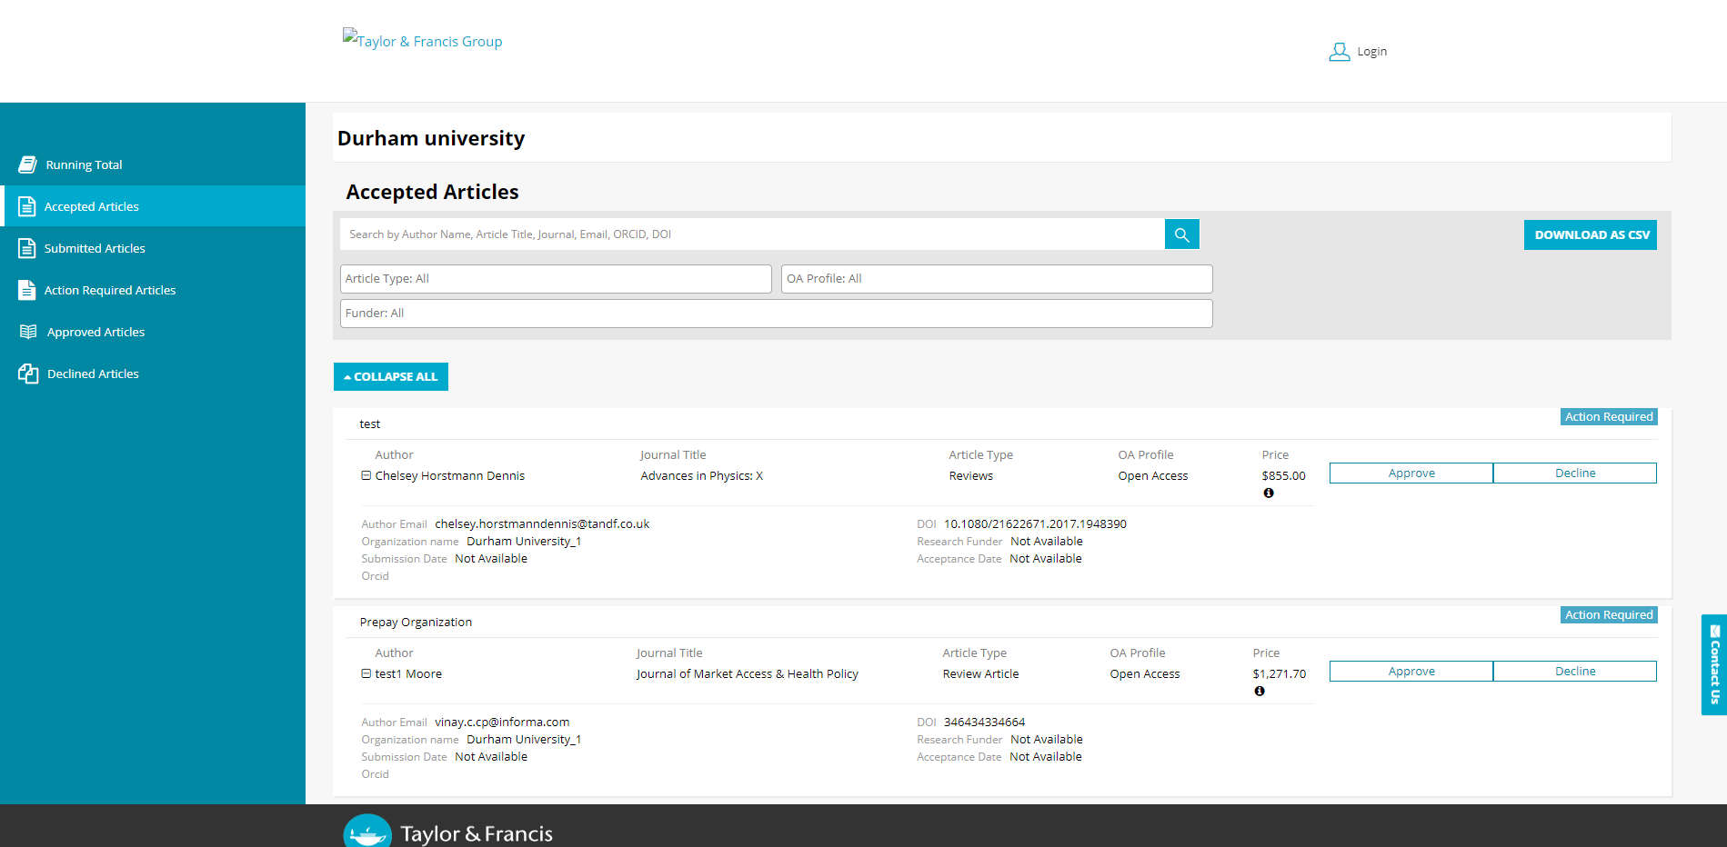
If the organizational user approves the article before the author gets to the licence email:

Slide 11
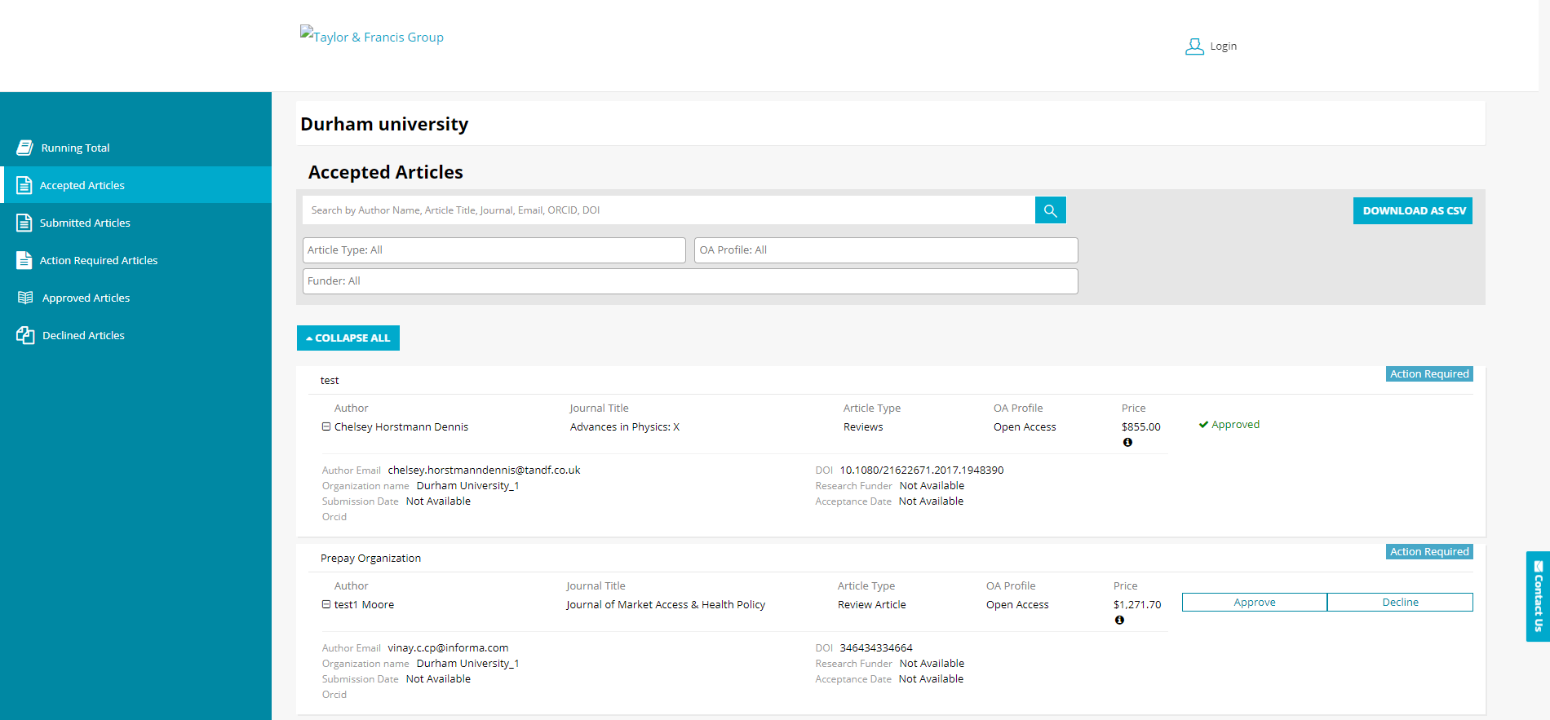

Slide 12
Approved Article Email to Author
Send To: Author Email
Subject: Gold Open Access funding approval for your article
Body:
Dear Author First Name Last Name,
Re: Article Title; Journal Title
We recently emailed you to let you know that your institution has an open access agreement with Taylor & Francis. We’re pleased to let you know that your library has approved Gold Open Access funding for your article through their Research Dashboard.
This means that your article will be published open access; it will be available online for anyone to read, anywhere.
What happens next?
If you have already signed an open access publishing agreement, you don’t need to do anything.
If you have not yet signed a publishing agreement, or have already signed a non-open access publishing agreement, then you will receive an email asking you to sign a new publishing agreement. You will be asked to choose a Creative Commons licence, you can find more information about licence choice here. http://authorservices.taylorandfrancis.com/publishing-agreements-your-options. Please note that this can take 24 to 48 hours to reach you.
You will not be asked for any payment.
If you have any queries, please contact apc@tandf.co.uk
Best wishes,
Taylor & Francis Group

Slide 13
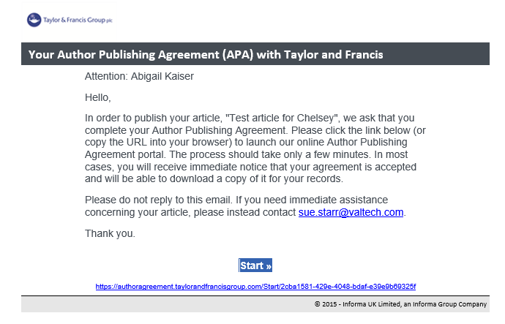

Slide 14
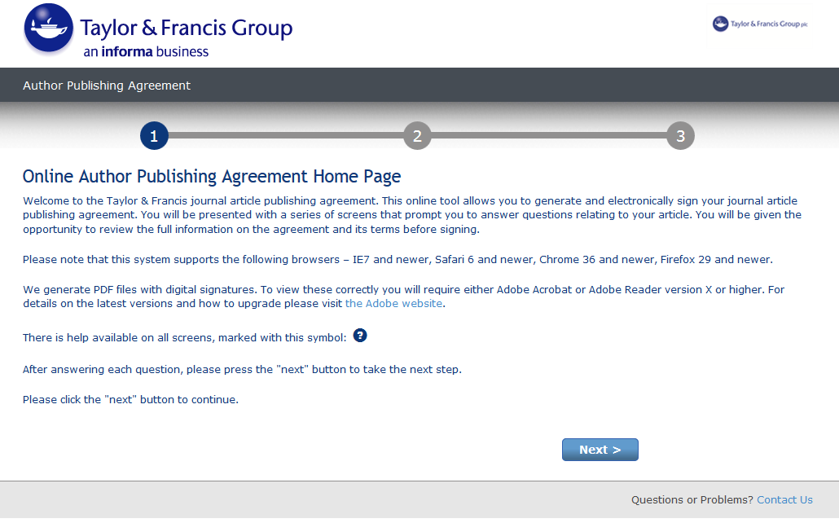
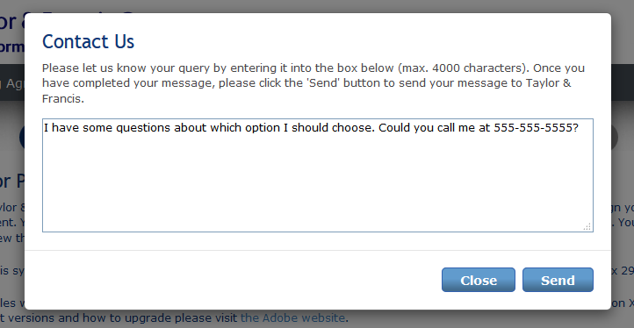

Slide 15
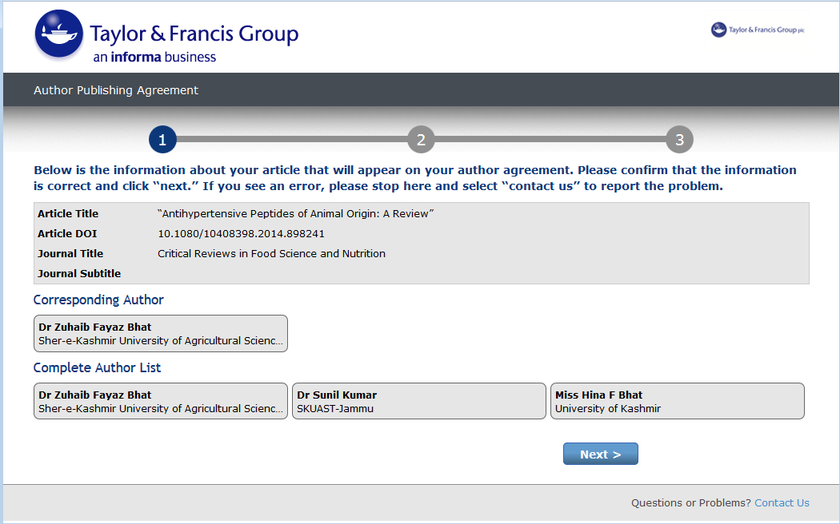

Slide 16
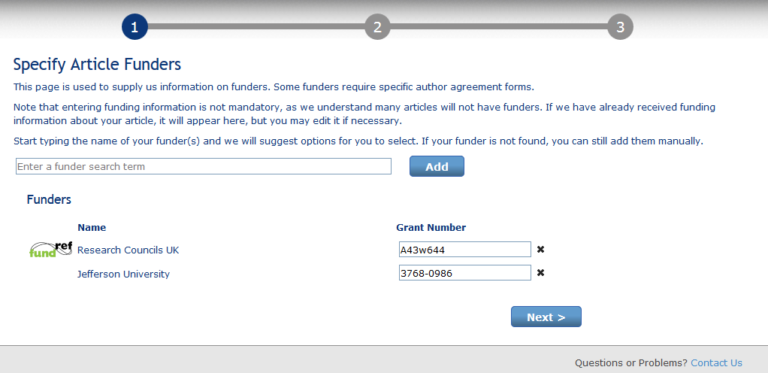

Slide 17
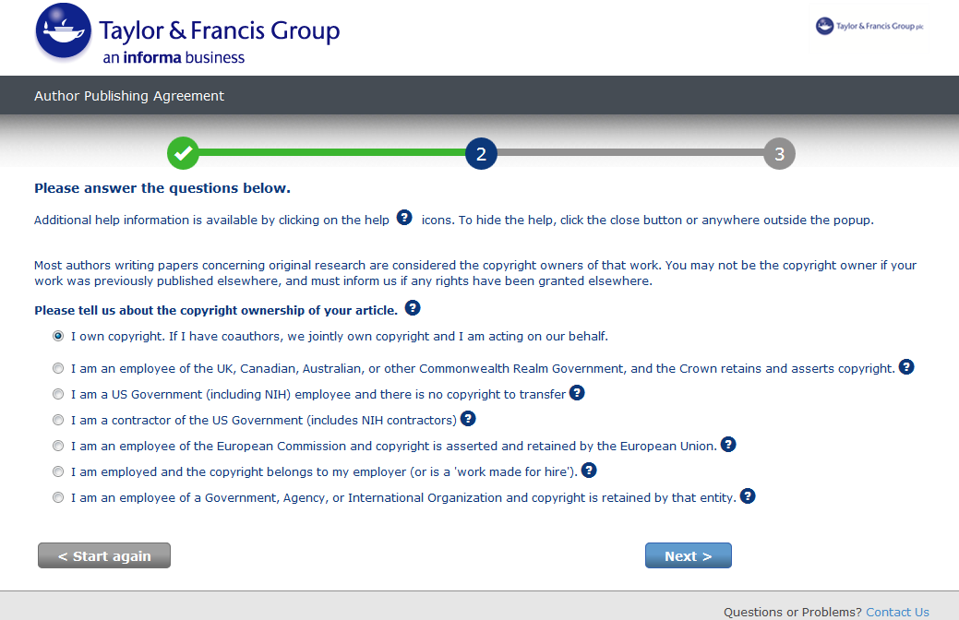

Slide 18
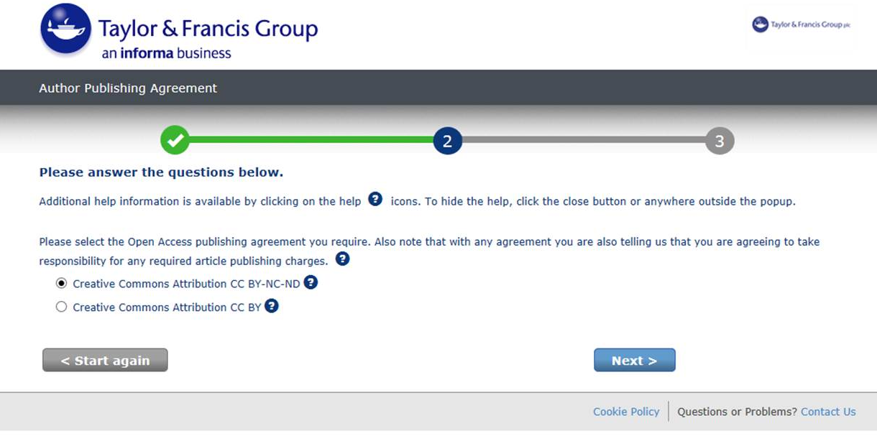
Taken directly to OA licence options

Slide 19
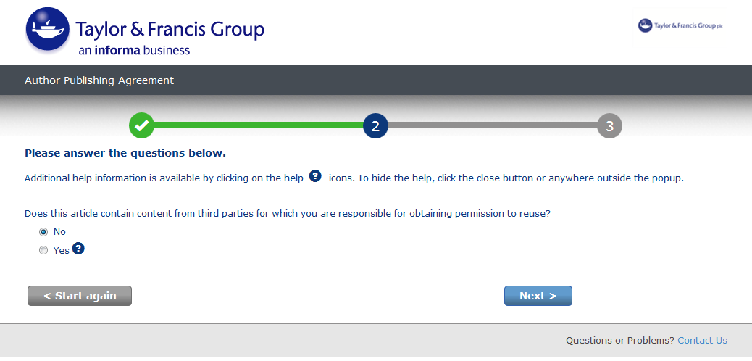

Slide 20
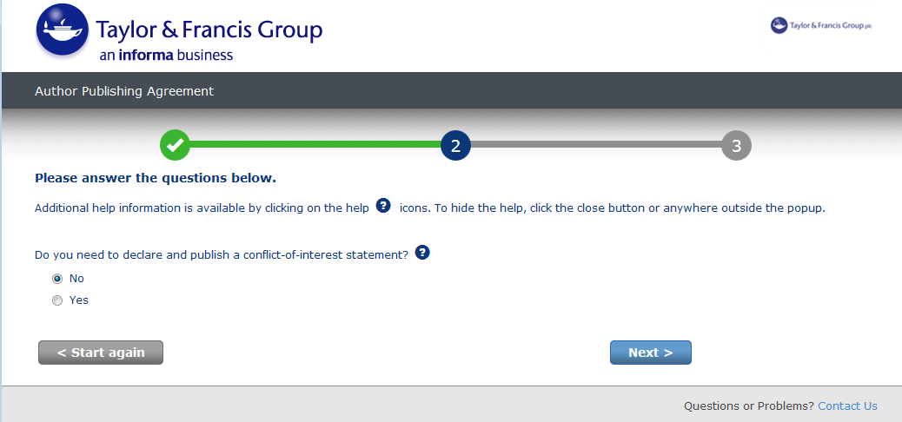

Slide 21
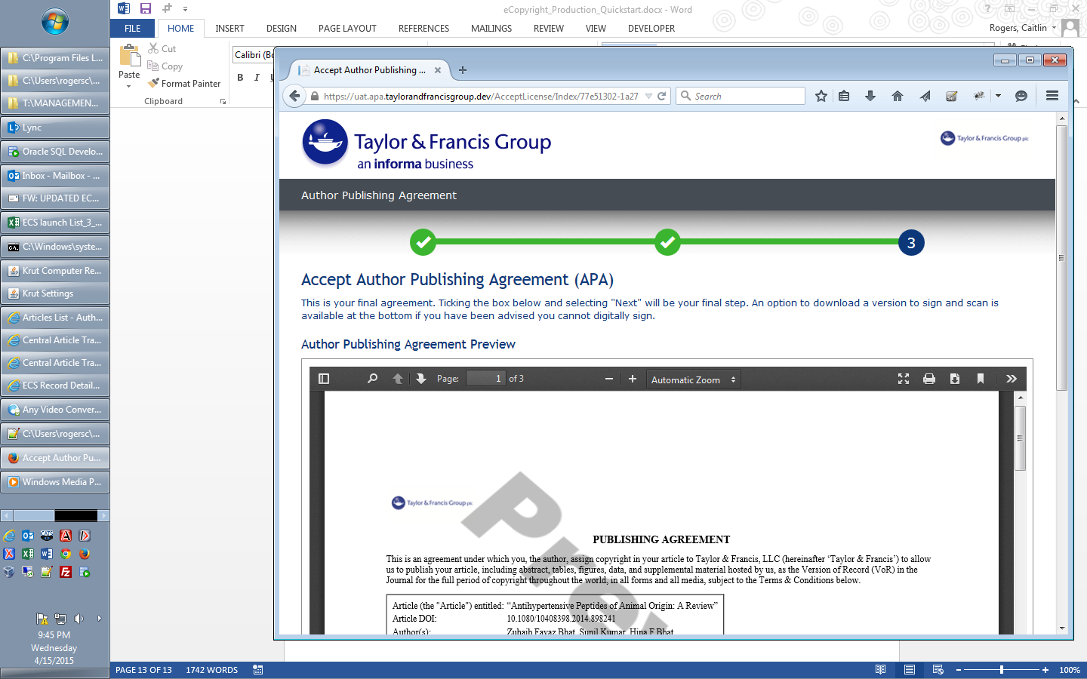
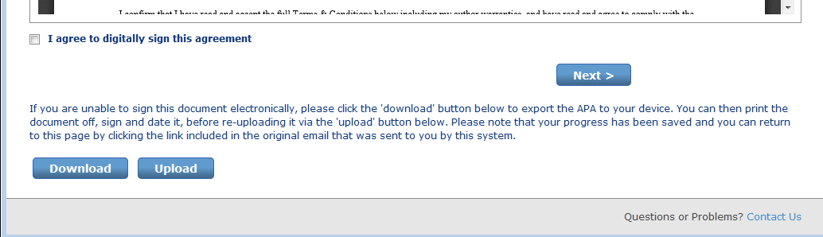

Slide 22
Workflow 2:
Author signs publishing agreement and chooses OA before library approves for OA funding via Dashboard

Slide 23
New Article Email to Author
Send To: Author Email
Subject: Your article with Taylor & Francis
Body:
Dear Author First Name Last Name,
Re: Article Title; Journal Title
Congratulations on the recent acceptance of your manuscript submission to Journal Title. The Taylor & Francis production team will work with you to publish your article online as quickly as possible.
We would like to let you know that your institution has an open access agreement with Taylor & Francis, which means you may be eligible for funding to publish your article open access. We have let them know that your paper has been accepted and shared your article information, including your email address.
What happens next?
It’s important to know that not all articles will be eligible for funding under this agreement, so please click here to view the latest information.
If your institution approves open access funding for your article, we will let you know. You may also request approval by selecting the open access option.
Look out for an email inviting you to select and sign your article publishing agreement.
If you have any questions, please do not hesitate to contact apc@tandf.co.uk, or your librarian.
Kind regards,
Mark Robinson
Taylor & Francis open access team
Email to author, alerting them to OA agreement

Slide 28
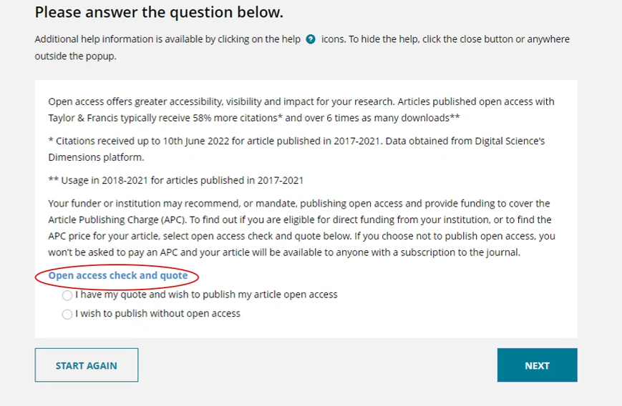
Author given the option to publish Open Access
NB: if the author selects no to Open Access here, the library can still approve the article for OA funding via the Dashboard and the author will receive a new OA licence to sign

Slide 29
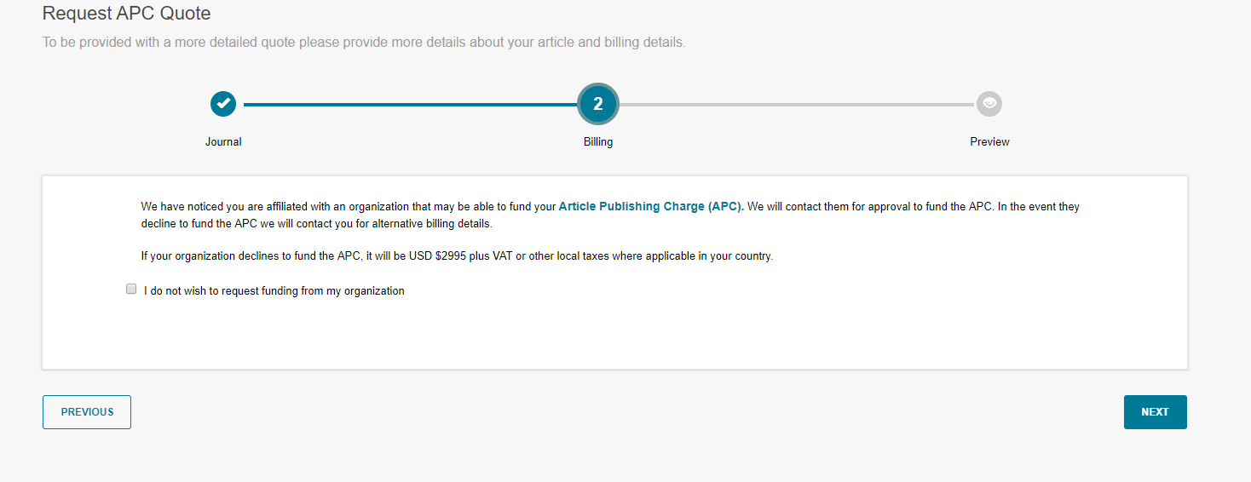
The system has recognised that the institution is part of the agreement and therefore directs the author to this page, letting them know that they may be eligible for APC funding

Slide 30
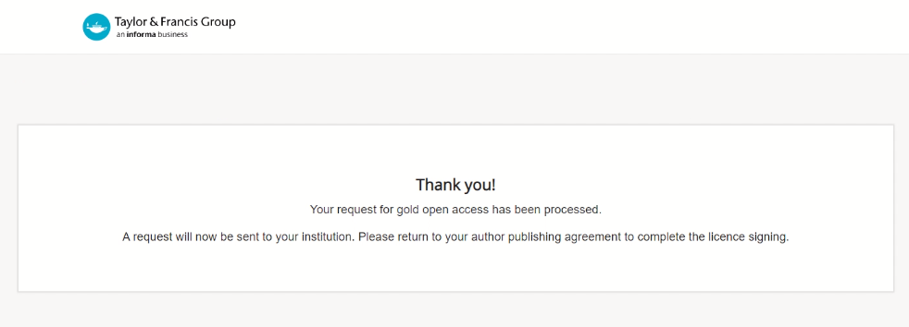

Slide 31
Relevant OA licence options displayed

Slide 33
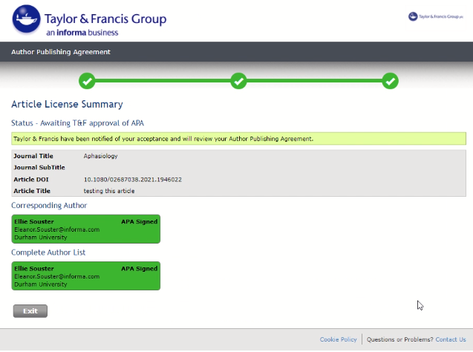

Slide 34
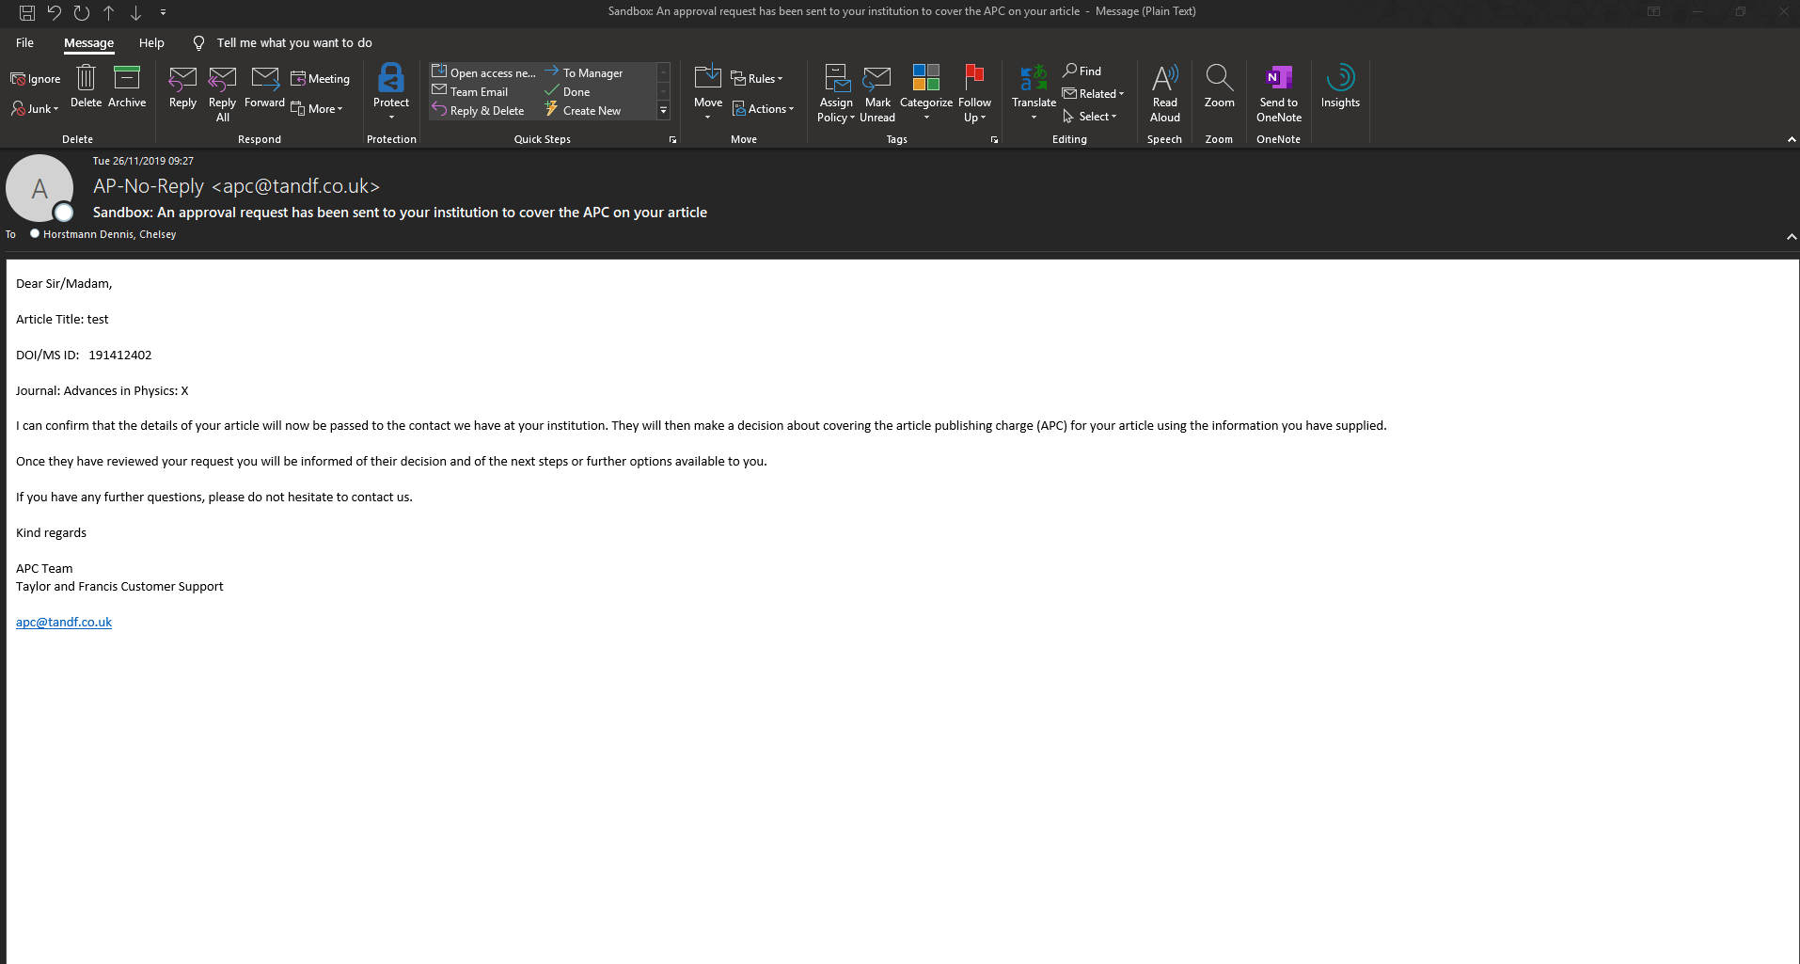
Once they confirm that they wish to ask the institution for funding, they receive this email.

Slide 35
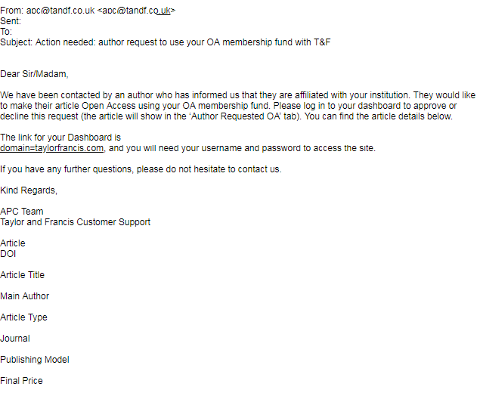
Notification to library
Library

Slide 36
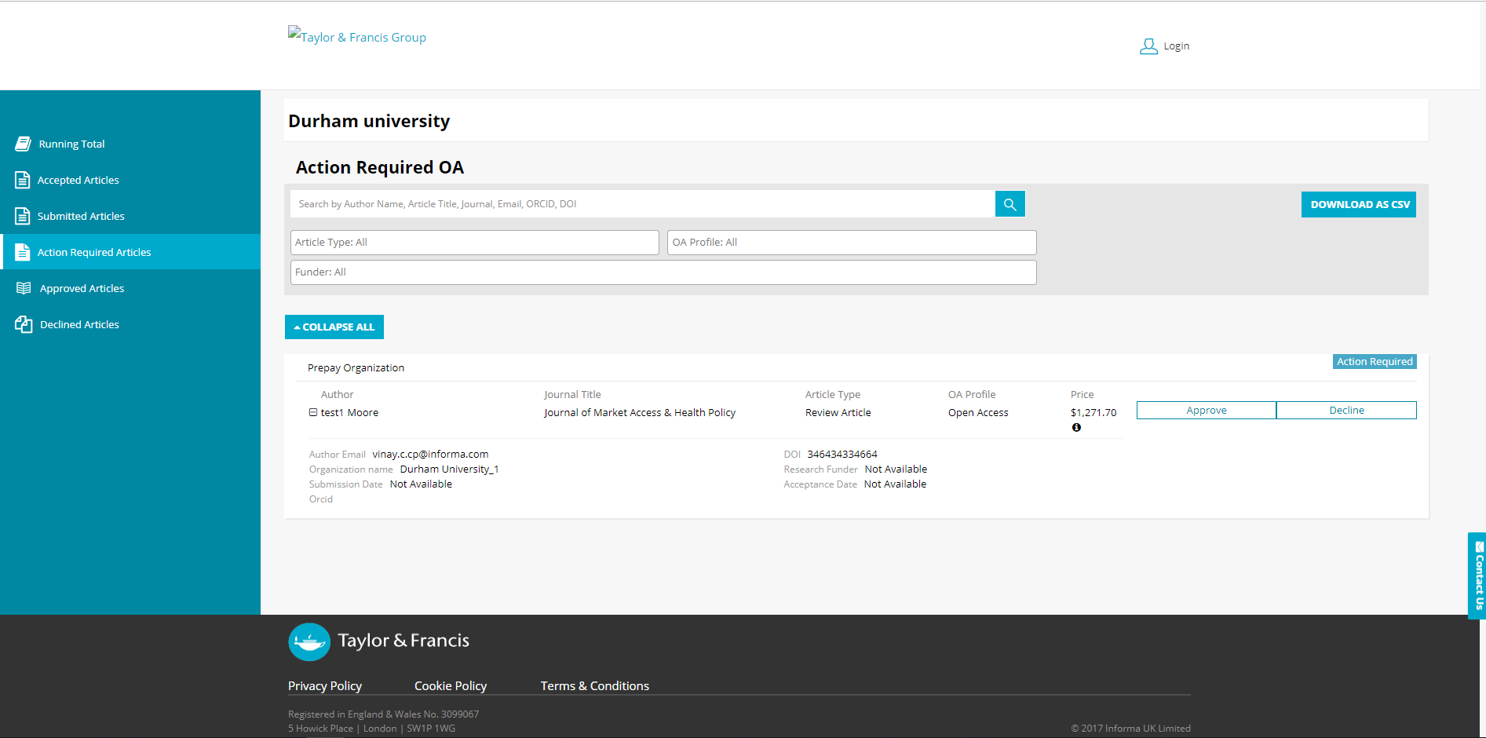
This article will then appear on your action required tab as the author has requested this funding. You then have the ability to approve or decline.

Slide 37
Approved Article Email to Author
Send To: Author Email
Subject: Gold Open Access funding approval for your article
Body:
Dear Author First Name Last Name,
Re: Article Title; Journal Title
We recently emailed you to let you know that your institution has an open access agreement with Taylor & Francis. We’re pleased to let you know that your library has approved Gold Open Access funding for your article through their Research Dashboard.
This means that your article will be published open access; it will be available online for anyone to read, anywhere.
What happens next?
If you have already signed an open access publishing agreement, you don’t need to do anything.
If you have not yet signed a publishing agreement, or have already signed a non-open access publishing agreement, then you will receive an email asking you to sign a new publishing agreement. You will be asked to choose a Creative Commons licence, you can find more information about licence choice here. http://authorservices.taylorandfrancis.com/publishing-agreements-your-options. Please note that this can take 24 to 48 hours to reach you.
You will not be asked for any payment.
If you have any queries, please contact apc@tandf.co.uk
Best wishes,
Taylor & Francis Group
Author receives confirmation of OA funding

Slide 38
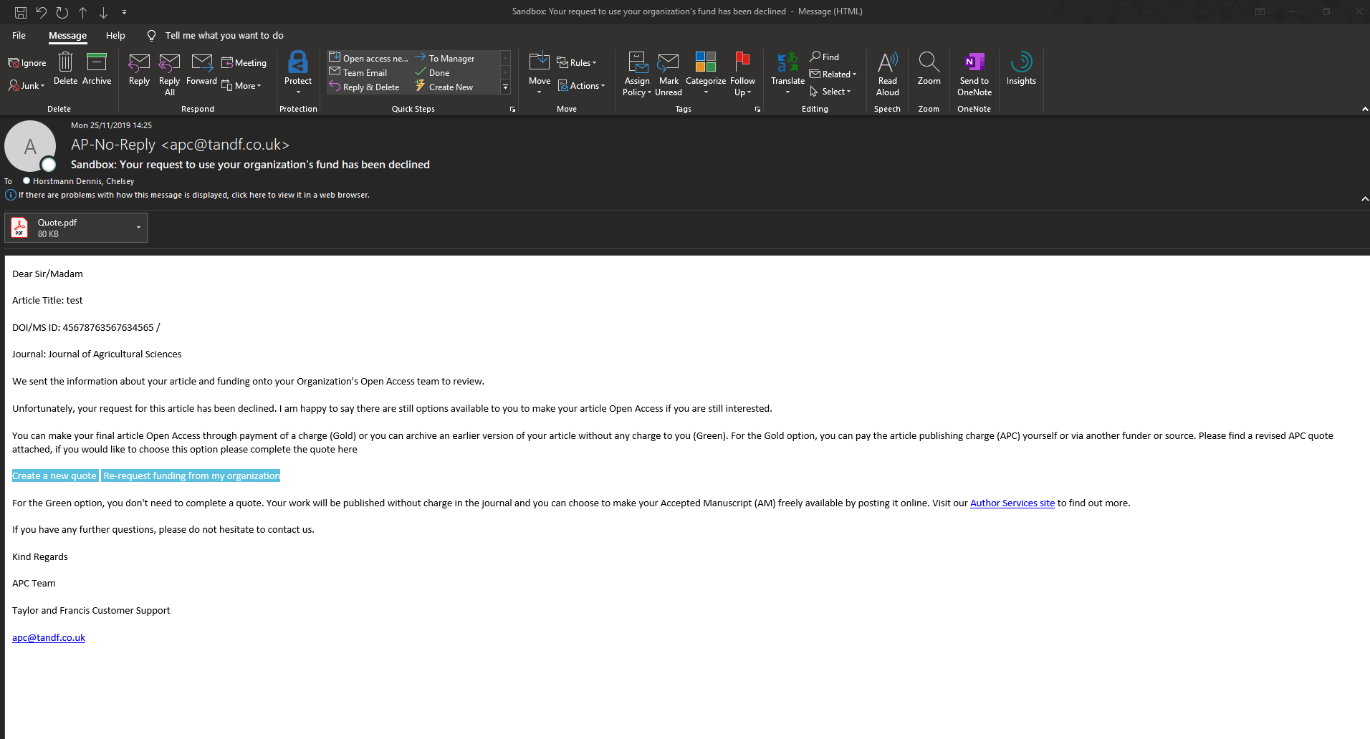
If the funding is declined by the institution the author will receive this email. They can still choose OA if they wish (they will need to create a new quote with a new payer) or go down the green OA route.

Slide 39
For further questions, please contact:
oalibrarianenquiries@tandf.co.uk

